Slide 1
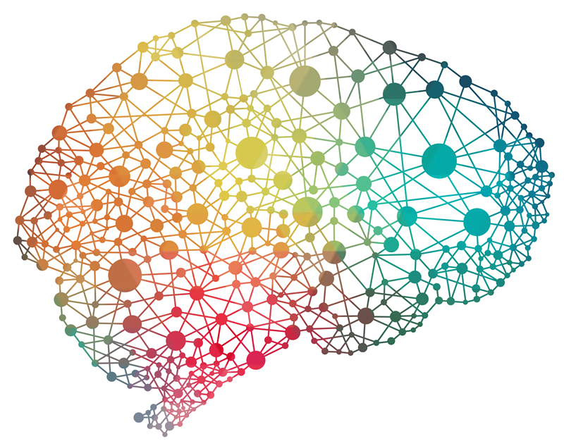
Bayesian Neural Networks
Math 538
Spring 17
Jason & greg

Slide 2
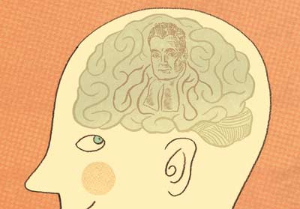
Introduction & Motivation
Why use Bayesian Neural Networks?

Slide 3
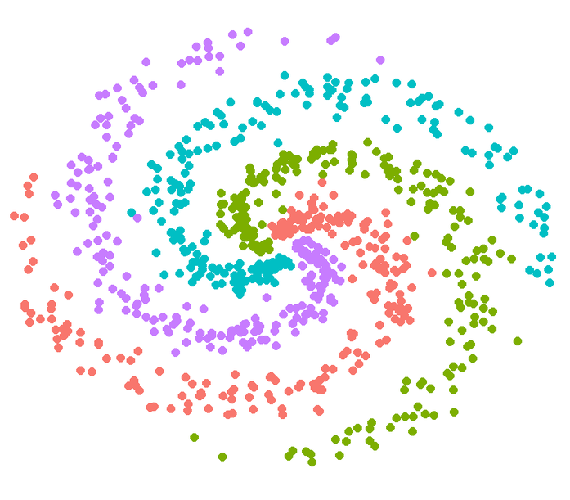
Motivation: Neural Nets
Why use Neural Networks?
Adaptive & data-driven
Powerful & flexible without overfitting
Fit real-world data
Short-comings
Pre-specified architecture
Point estimates

Slide 4
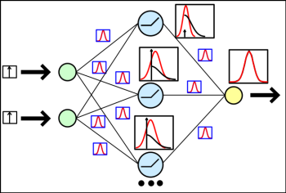
Motivation: Bayesian Neural Nets
Bayesian Neural network places priors on parameters and models and makes predictions based on posterior predictive distribution.
Why use Bayesian Neural Networks?
Incorporate prior knowledge (e.g. previous architectures)
Small(ish) sample size
Prevent overfitting
Let data determine network architecture and tuning parameters
Posterior predictive distributions for any variables of interest
Notes:
Credible intervals & HPDs

Slide 5

Structure of the Model
Architecture, Priors, & Posterior Sampling

Slide 6
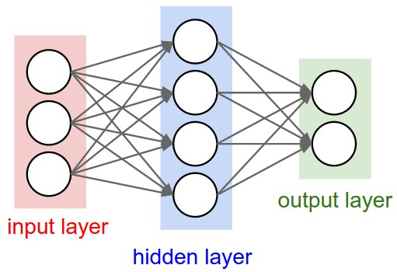
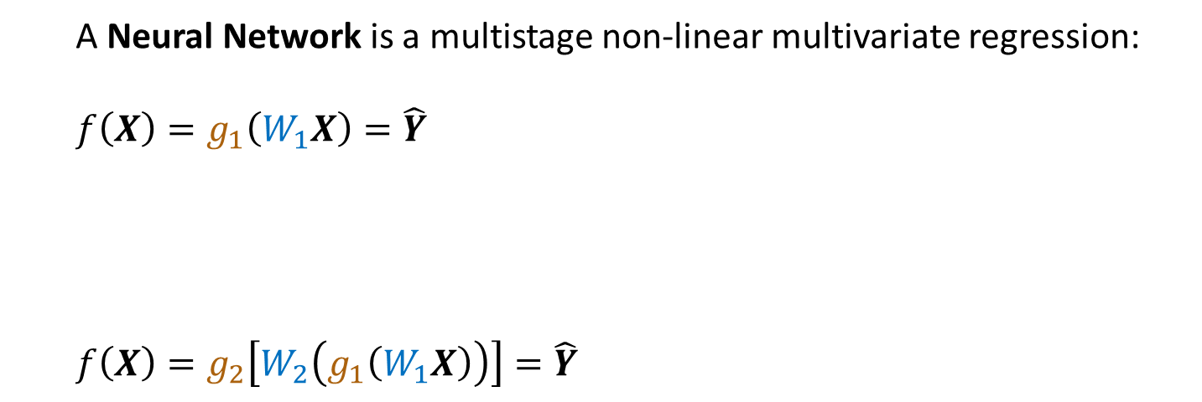



NN Architecture
A Neural Network is a multistage non-linear multivariate regression:
$$f\left(X\right)=g_{1}\left(W_{1}X\right)=\hat{Y}$$
$$f\left(X\right)=g_{2}\left[W_{2}\left(g_{1}\left(W_{1}X\right)\right)\right]=\hat{Y}$$
Multivariate
Regression
Nonlinearity
$$g_{2}\left[W_{2}\left(g_{1}\left(W_{1}X\right)\right)\right]$$
Stage/Layer One
$$X$$
$$g_{1}\left(W_{1}X\right)$$
Stage/Layer Two
Notes:
Let’s look at the functional form

Slide 7
Setting Priors
Difficult to incorporate sophisticated background/expert information into the model via priors.
Setting priors is an alternative to guessing/cross-validating parameters
Weight priors can be:
Hierarchically specified
Assigned based on weight type, forming groups
Zero-mean Gaussian

Slide 8
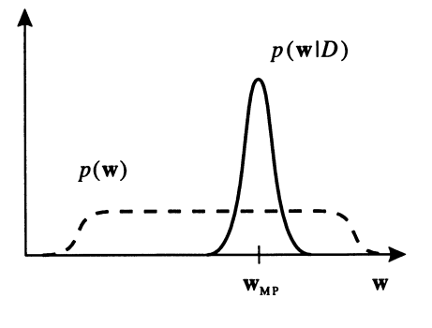
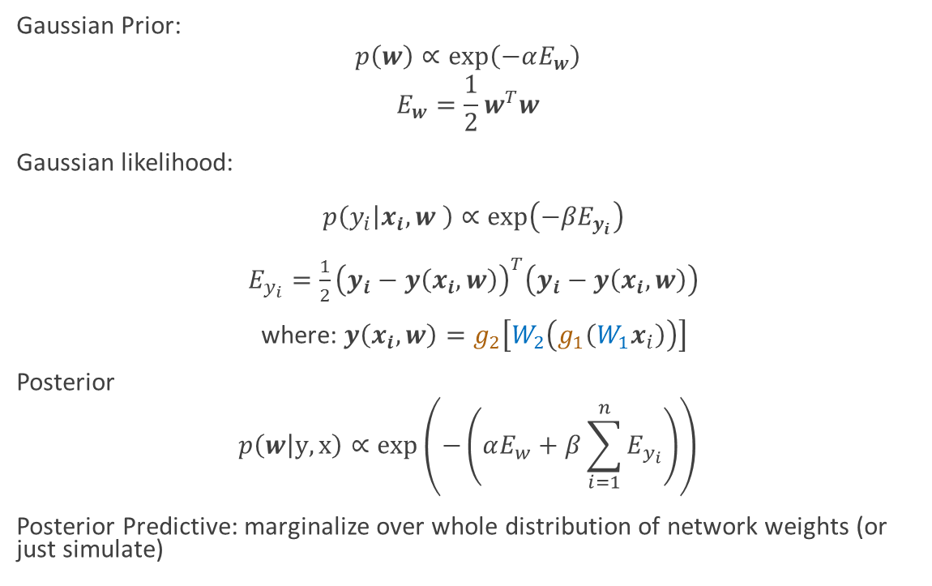
A Simple Specification
Gaussian Prior:
$$p\left(w\right)∝\exp\left(−αE_{w}\right)$$
$$E_{w}=\frac{1}{2}w^{T}w$$
Gaussian likelihood:
$p\left(y_{i} | x_{i},w \right)∝\exp\left({−βE}_{y_{i}}\right)$
$E_{y_{i}}=\frac{1}{2}{\left(y_{i}−y\left(x_{i},w\right)\right)}^{T}\left(y_{i}−y\left(x_{i},w\right)\right)$
where: $y\left(x_{i},w\right)=g_{2}\left[W_{2}\left(g_{1}\left(W_{1}x_{i}\right)\right)\right]$
Posterior
$$p\left(w | y,x\right)∝\exp\left(−\left(αE_{w}+β\sum_{i=1}^{n}{E_{y_{i}}}\right)\right)$$
Posterior Predictive: marginalize over whole distribution of network weights (or just simulate)

Slide 9
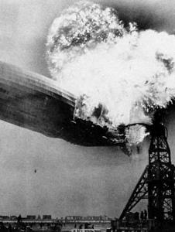
Complications
Why does traditional MCMC fail?
Model complexity (huge parameter space)
Three Approaches
Gaussian Approximation
Hybrid Monte Carlo
Variational Inference

Slide 10
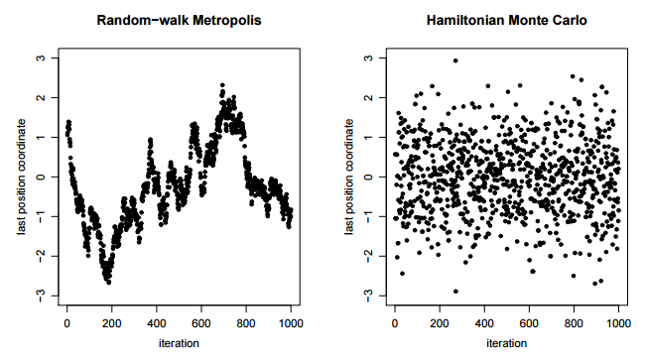
Hybrid Monte Carlo
Random walk MCMCs are inherently inefficient. In high dimensions, reparameterization and efficient jumping rules don’t help.

Slide 11
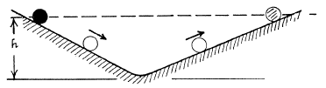
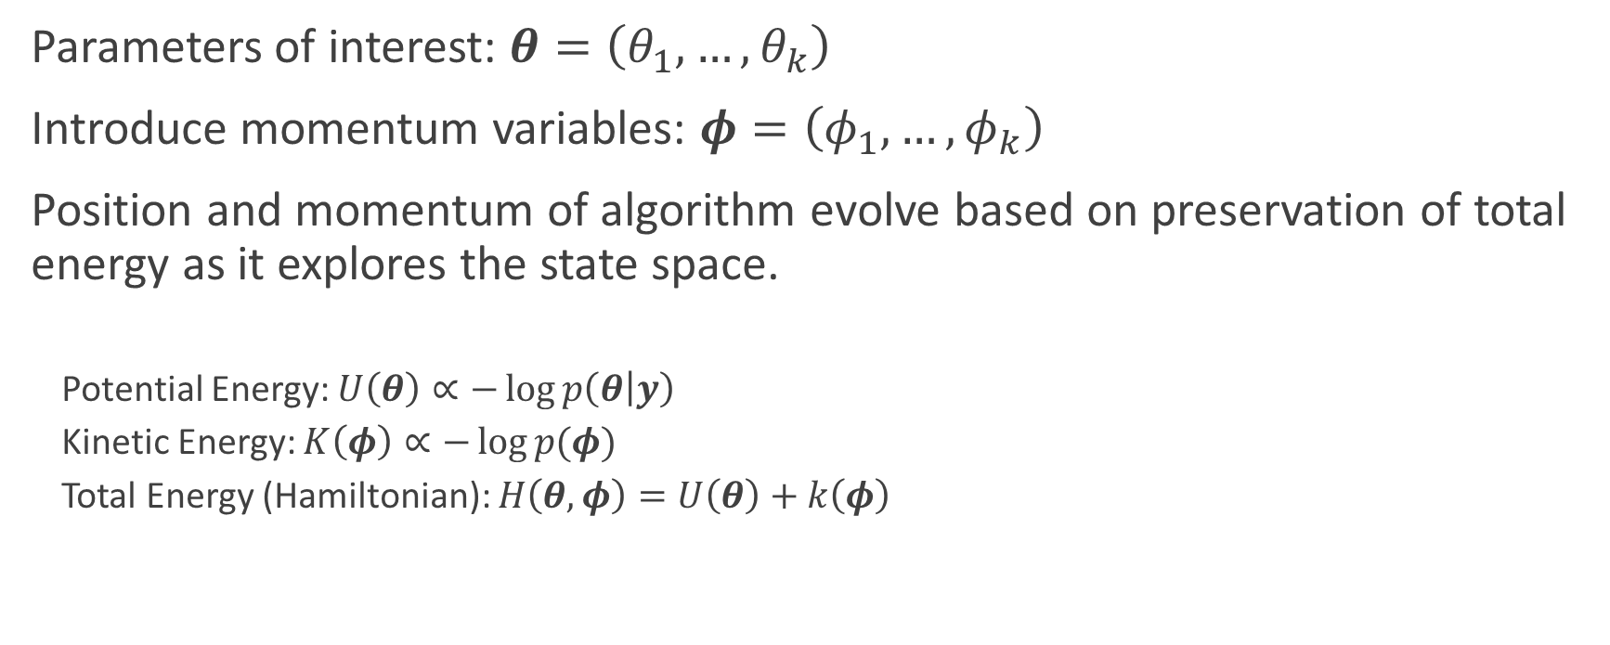
Hybrid Monte Carlo
Parameters of interest: $θ=\left(θ_{1},…,θ_{k}\right)$
Introduce momentum variables: $φ=\left(φ_{1},…,φ_{k}\right)$
Position and momentum of algorithm evolve based on preservation of total energy as it explores the state space.
Potential Energy: $U\left(θ\right)∝−\log{p\left(θ | y\right)}$
Kinetic Energy: $K\left(φ\right)∝−\log{p(φ)}$
Total Energy (Hamiltonian): $H\left(θ,φ\right)=U\left(θ\right)+k\left(φ\right)$

Slide 12
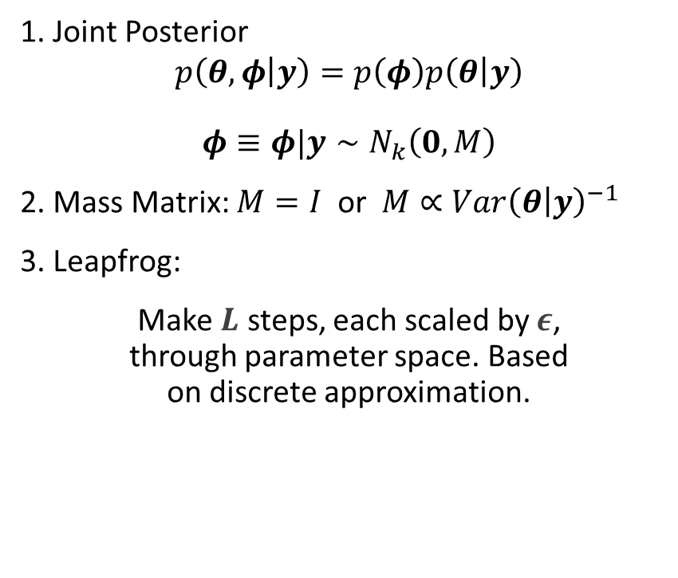
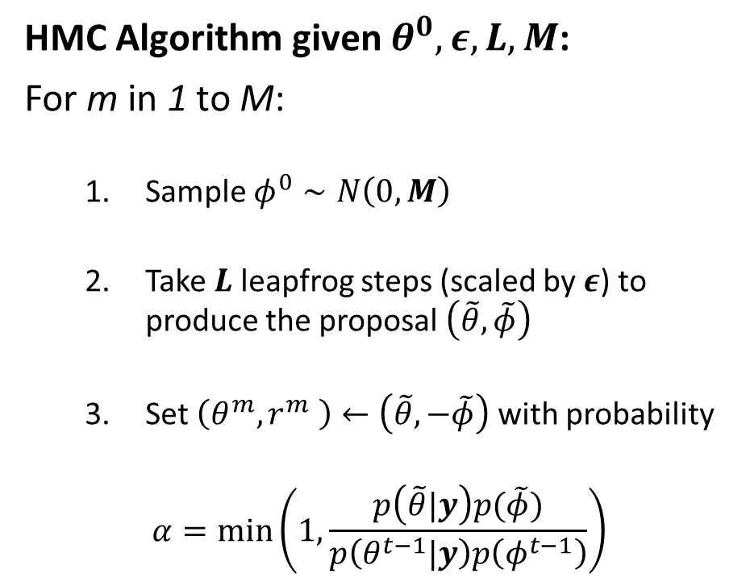
Hybrid Monte Carlo
1. Joint Posterior
$$p\left(θ,φ | y\right)=p\left(φ\right)p\left(θ | y\right)$$
$$φ≡φ|y∼N_{k}\left(0,M\right)$$
2. Mass Matrix: $M=I$ or $M∝Var{\left(θ | y\right)}^{−1}$
3. Leapfrog:
Make $L$ steps, each scaled by $ε$, through parameter space. Based on discrete approximation.
HMC Algorithm given $θ^{0},ε,L,M$:
For m in 1 to M:
Sample $φ^{0}∼N\left(0,M\right)$
Take$L$leapfrog steps (scaled by $ε$) to produce the proposal $\left(\tilde{θ},\tilde{φ}\right)$
Set $\left(θ^{m},r^{m} \right)←\left(\tilde{θ},−\tilde{φ}\right)$ with probability
$$α=\min\left(1,\frac{p\left(\tilde{θ}|y\right)p(\tilde{φ})}{p\left(θ^{t−1}|y\right)p\left(φ^{t−1}\right)}\right)$$
Notes:
Leapfrog is a discrete approximation to how the algorithm evolves over time in terms of position and momentum

Slide 13
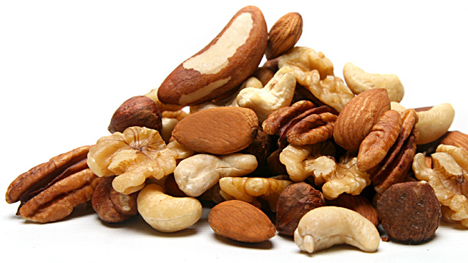
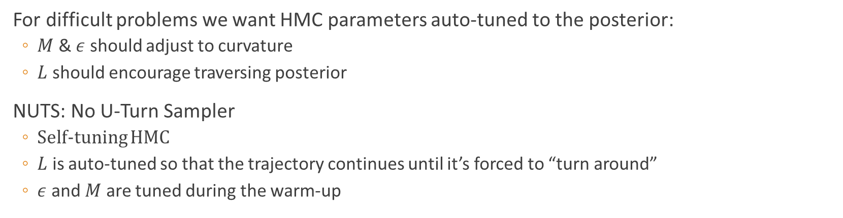
NUTS
For difficult problems we want HMC parameters auto-tuned to the posterior:
$M$ & $ε$ should adjust to curvature
$L$ should encourage traversing posterior
NUTS: No U-Turn Sampler
Self-tuning HMC
$L$ is auto-tuned so that the trajectory continues until it’s forced to “turn around”
$ε$ and $M$ are tuned during the warm-up
Notes:
$M$ scaled to local curvature
$ε$ gets smaller when curvature is high
$L$ large enough so the trajectory traverses the posterior

Slide 14
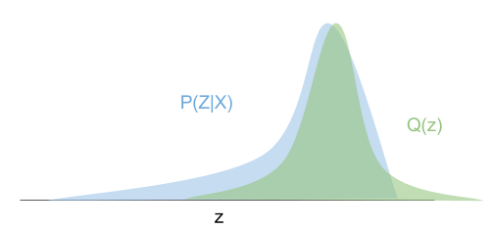
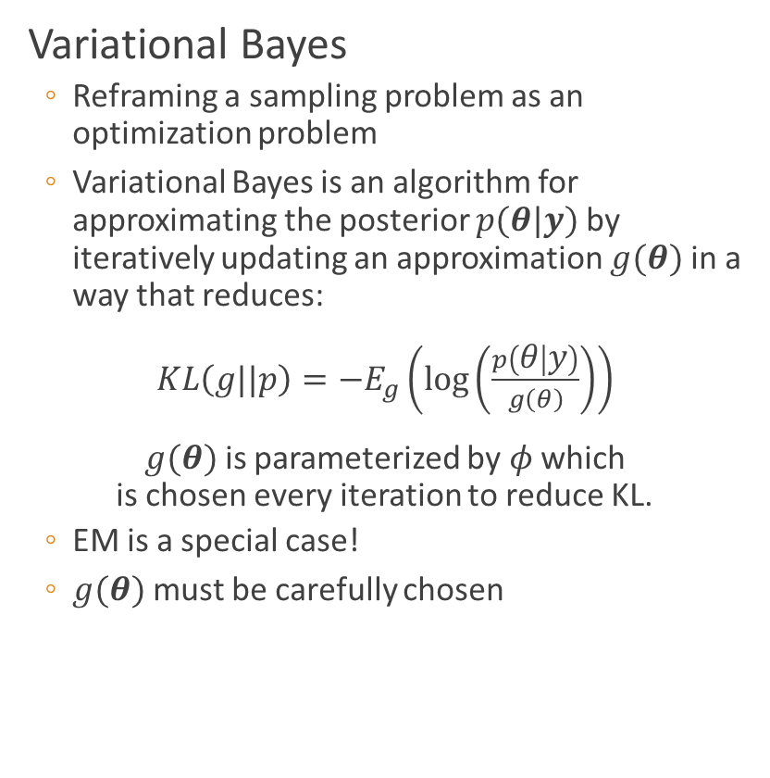



Variational Inference
Variational Bayes
Reframing a sampling problem as an optimization problem
Variational Bayes is an algorithm for approximating the posterior $p(θ|y)$ by iteratively updating an approximation $g(θ)$ in a way that reduces:
$KL\left(g||p\right)=−E_{g}\left(\log\left(\frac{p\left(θ | y\right)}{g\left(θ\right)}\right)\right)$
$g(θ)$ is parameterized by $φ$ which is chosen every iteration to reduce KL.
EM is a special case!
$g(θ)$ must be carefully chosen
$$p(θ|y)$$
$$g(θ|φ)$$
$$θ$$
Notes:
Like EM

Slide 15
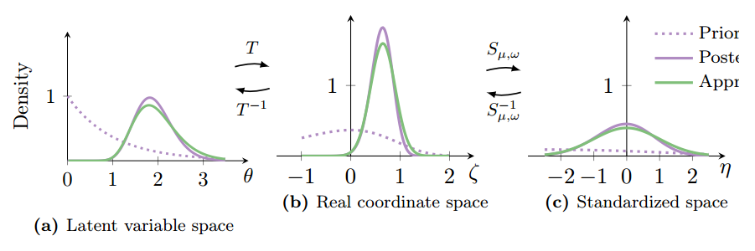

ADVI
Automatic Differentiation Variational Inference (ADVI)
ADVI automatically determines $g(θ)$ and determines an algorithm for optimization.
Only a Bayesian model and dataset required!
Transformation-based approach
Transform latent variables to the Real Coordinate Space: $T: supp\left(p\left(θ\right)\right)→ℝ^{k}$
Propose a Gaussian $g(θ)$ on $ℝ^{k}$
Standardize.
Maximize ELBO (equiv. to minimizing KL)
Consistently faster than NUTS!
Prior
Posterior
Approx.
Notes:
Like EM

Slide 16
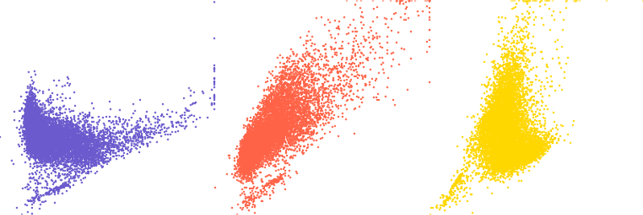
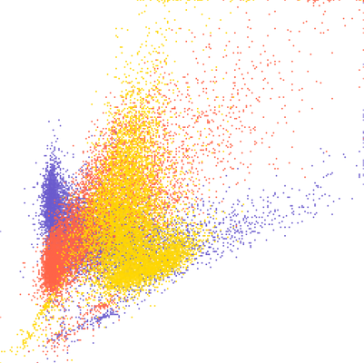
BNN Application
Implementation, Model Fitting, & Performance
Notes:
Purple: rgb = (106, 90, 205)
Red: rgb =(255,99,71)
Gold: rgb = (255,215,0)

Slide 17
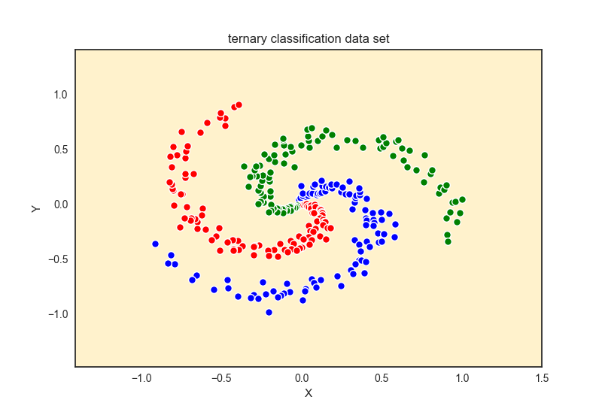
Datasets
Toy dataset for classification:
Two-dimensional data, which can be classified into 3 groups.

Slide 18
GLM approach
Where
for
For each observation
we want to maximize .
Then we can define a loss function as
. By minimizing L with respect to and , we can solve the system.

Slide 19
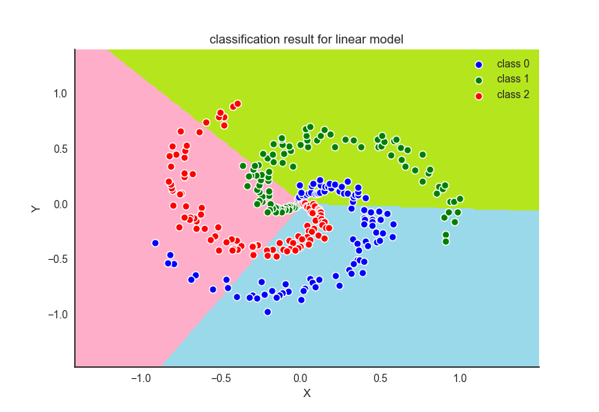
GLM approach
The group boundaries in the data space do not fit straight lines very well, the linear model apparently would not provide us decent results.

Slide 20
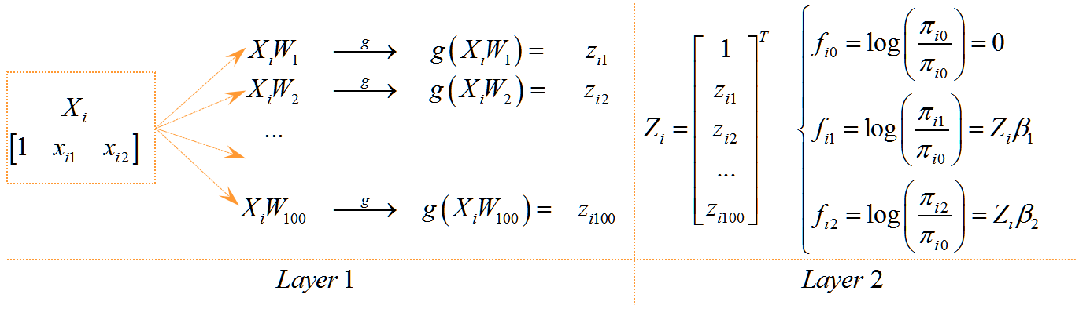
NN approach
We may setup a Neural Network to construct the non-linear model.
The system can be solved using both Frequentist and Bayesian methods.

Slide 21
NN approach(Frequentist method)
For each observation
we want to maximize .
Then we can define a loss function as
. By minimizing L with respect to , and , we can solve the system.

Slide 22
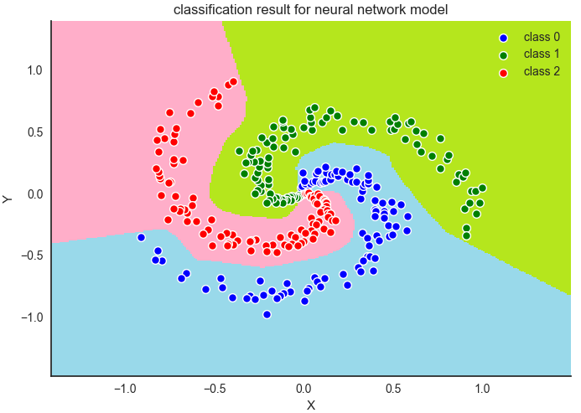
NN approach(Frequentist method)

Slide 23

NN approach(Bayesian method)
Set as the vector of all parameters need to be estimated in the NN architecture.

Slide 24
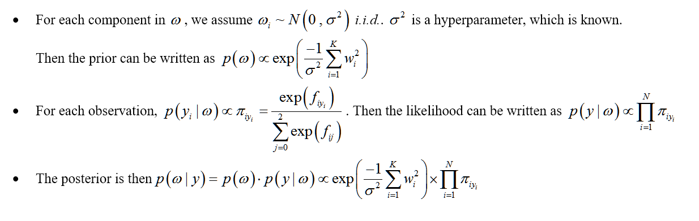
NN approach(Bayesian method)
We have two different approaches to understand the behaviors of this posterior. One is to sample from the density, using the samples to simulate the posterior (Hybrid Monte Carlo Method). Another one is to study an easier density, which can approximate the posterior (Gaussian Approximation or Variational Inference Method).

Slide 25
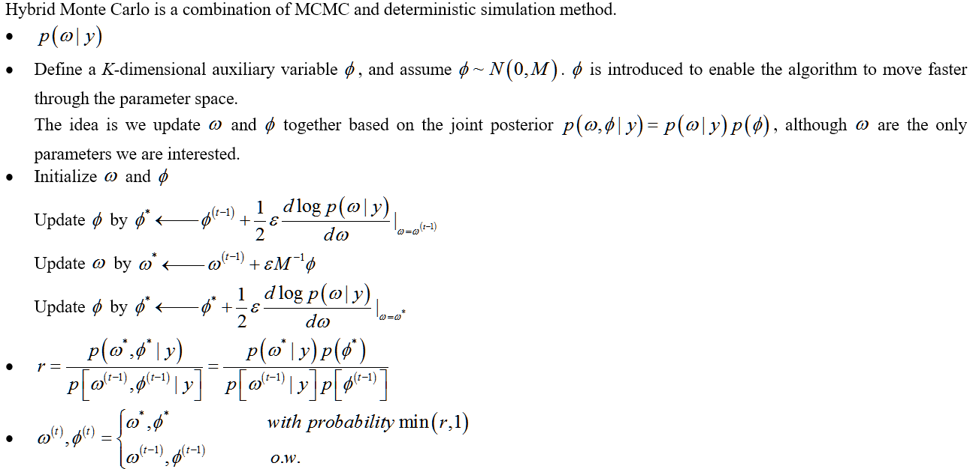
NN approach(Hybrid Monte Carlo)

Slide 26
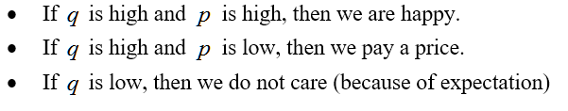
NN approach(Variational Inference)
q
p

Slide 27
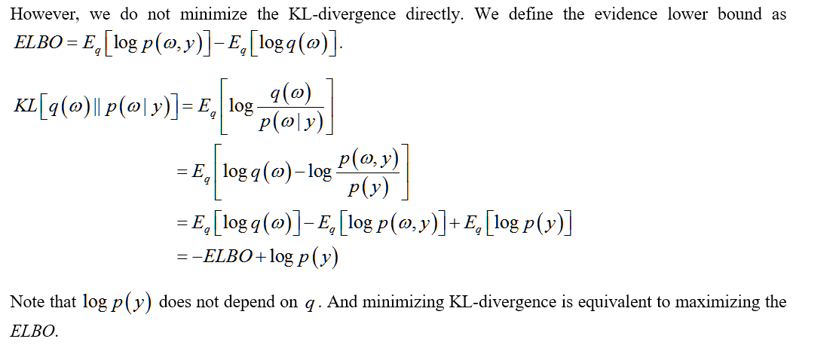
NN approach(Variational Inference)

Slide 28
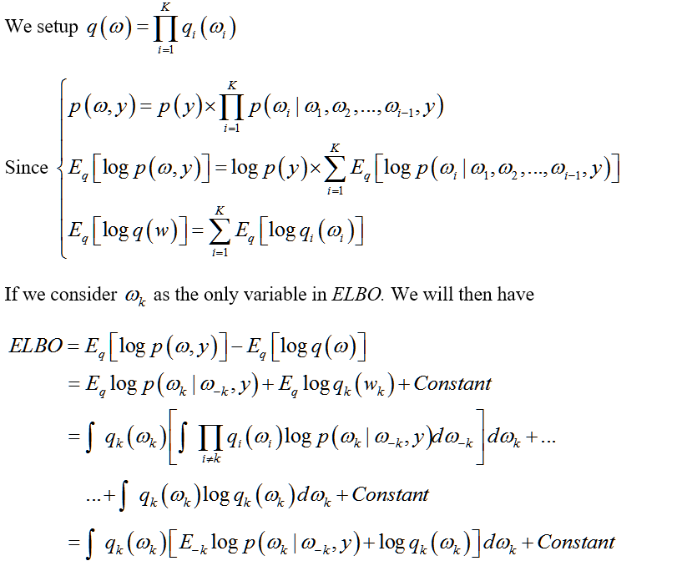
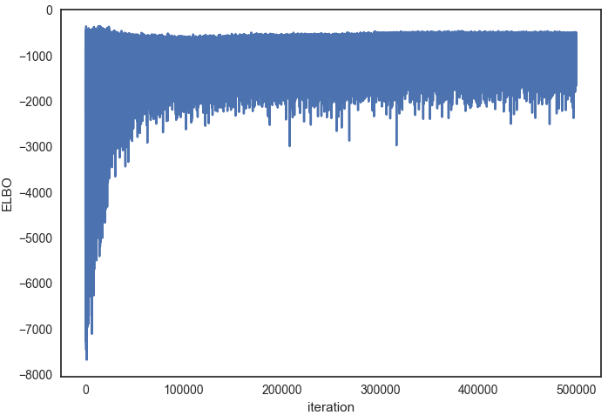
NN approach(Variational Inference)

Slide 29
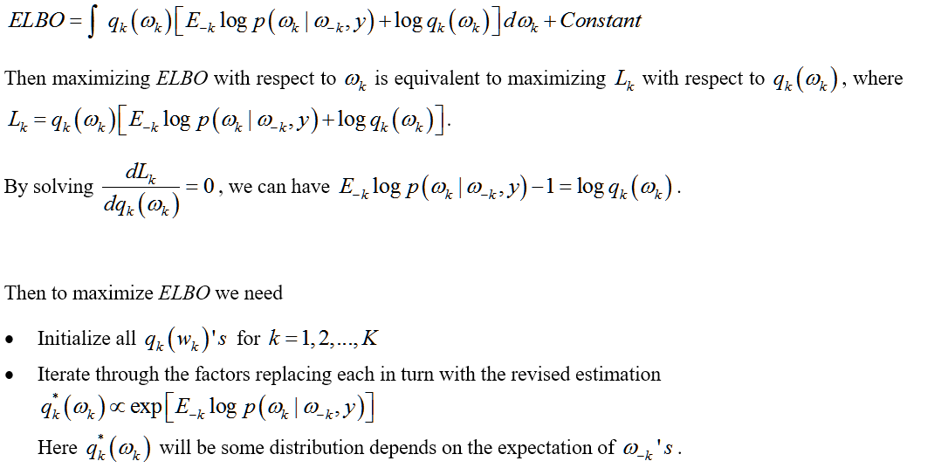
NN approach(Variational Inference)

Slide 30
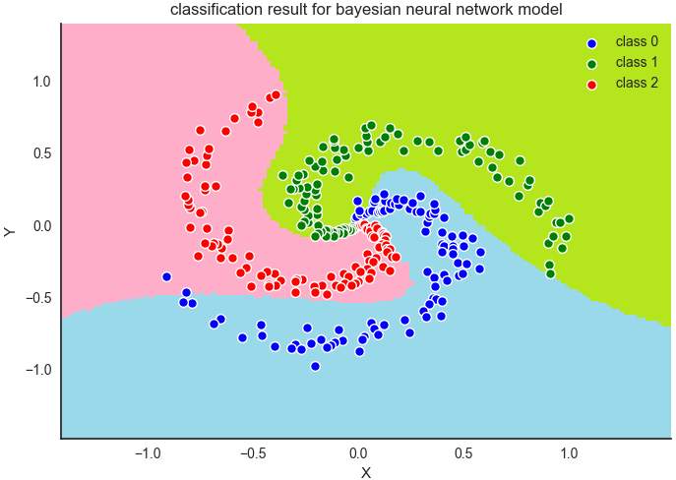
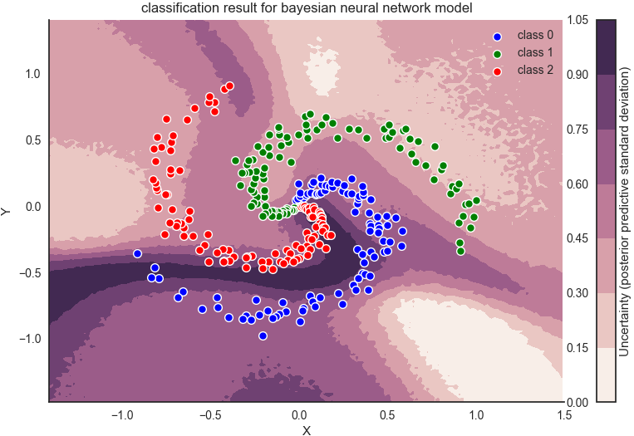
NN approach(Bayesian method)

Slide 31
References
Gelman, Andrew. Bayesian Data Analysis. CRC Press, 2013.
Goodfellow, Ian, and Yoshua Bengio. Deep Learning. MIT Press, 2017.
Wiecki, Thomas. “Bayesian Deep Learning.” Web blog post. While My MCMC Gently Samples. 1 Jun. 2016. Web. 19 Mar. 2017.
Rasmussen, Carl. “A Practical Monte Carlo Implementation of Bayesian Learning.” NIPS'95 Proceedings of the 8th International Conference on Neural Information Processing Systems, 1995, 598-604.
Neal, Radford. “MCMC using Hamiltonian Dynamics.” Handbook of Markov Chain Monte Carlo, edited by Gelman et al., Chapman & Hall, 2011, pp. 113-162.
Kucukelbir, Alp. “Automatic Variational Inference in STAN.” Cornell University Library, 2015.

Slide 32

Questions?

